Slide 1
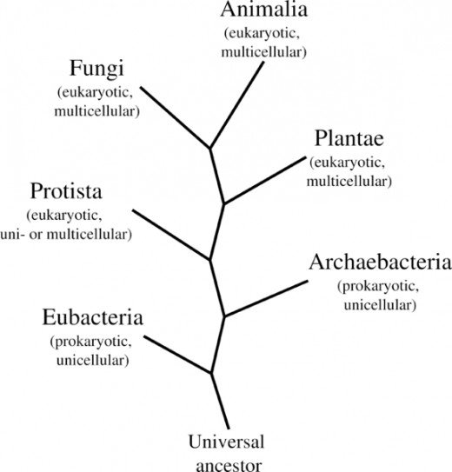

The six kingdoms
The six kingdom system consists of:
Eubacteria (bacteria)
Archaebacteria
Protista
Fungi
Plantae
Animalia
Come up with a mnemonic to remember these six kingdoms! – This mnemonic does not need to be in any particular order.
Process: Kingdoms
Gather: Kingdoms

Slide 2
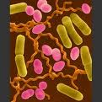
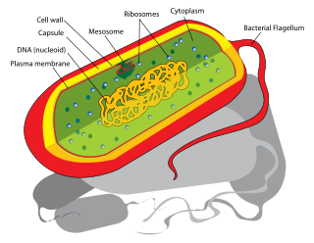
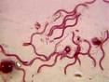
Kingdom Prokaroytae (MONERA) (bacteria and cyanobacteria)
Prokaryotes are everywhere
They have even been found in rocks miles below the earths surface
The number of prokaryotes in a single handful of soil is greater than the number of people who have ever lived!!!
Most prokaryotes are unicellular
Have a variety of shapes- cocci (spheres), bacilli (rods) and spiral
Do not have membrane bound organelles
https://youtu.be/ORB866QSGv8

Slide 3
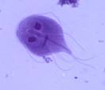
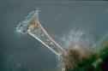
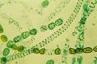
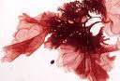
Kingdom Protoctista (PROTISTS)
a group in which organisms end up in if they are not prokaryotes, fungi, plants or animals
Protists are extremely diverse
Mostly unicellular
Usually found in aquatic environments
Includes algae (seaweeds), fungi (slime moulds) and protozoans e.g. amoeba
Have a cellulose cell wall
Reproduction highly varied- some exclusively asexual and some sexual
Many protists are parasites and pathogens
https://www.youtube.com/watch?v=UOfY26qdbU0

Slide 4
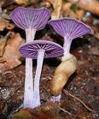
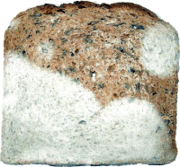
KingdoM FUnGi
Most are multicellular
Single celled fungi are yeasts
Includes, moulds, yeasts, mildews, mushrooms
Cannot photosynthesise
Heterotrophs feed by absorption
excrete powerful enzymes to the food source
This breaks down the food so it can be absorbed
Called extracellular digestion
Lysotrophs- decomposers
Can decompose dead materials

Slide 5
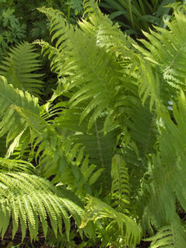
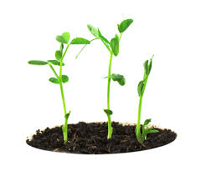
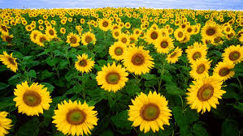
Kingdom Plantae
Plants have inhabited the earth for 500 million years!!!
All plants
Are autotrophs (self feeders or producers)
Have chlorophyll in chloroplasts (for photosynthesis)
Have a cellulose cell wall; food is stored as starch
Primitive plants (mosses) reproduce by spores (asexual reproduction)
Flowering plants produce seeds (sexual reproduction)

Slide 6
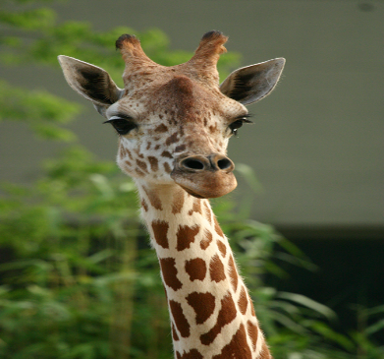
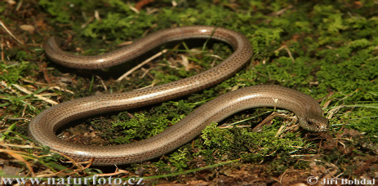
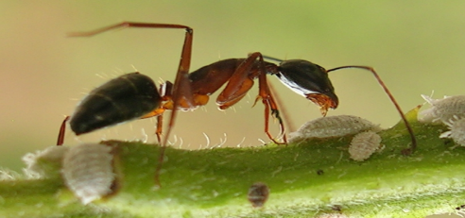
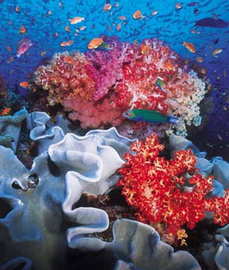
Kingdom Animalia
Are heterotrophs
Multicellular
Are capable of locomotion
The animal kingdom is split up into vertebrates and non-vertebrates
The non vertebrates or invertebrates phyla are
Annelids (worms, leeches)
Arthropods (insects, spiders, crustaceans)
Molluscs (snails, slugs, mussels, octopuses)
Echinoderms (sea stars, sea cucumber)
The vertebrates phylum are called chordates
Have an internal skeleton (endoskeleton)
Have a backbone
Notes:
Further subdivided into major phyla on basis of body symmetry; development of the coelom, and external and internal structures

Slide 7
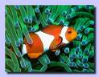
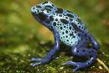
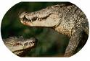
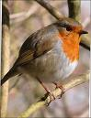
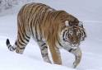
Chordates
Chordates
Fish
Amphibia
Reptilia
Aves
(Birds)
Mammalia

Slide 8
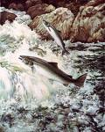
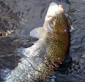
fish
Characteristics:
Live in water.
They are vertebrates.
Breathe using gills. They absorb oxygen through the gills.
Almost all fish are ectothermic, body temperature is not constant (cold-blooded).
Some fish have scales.
Large number of eggs produced when there is external fertilisation
Notes:
Some 550 million years ago, the first fish – the haikouichthys – evolved.
Haikouichthys were also the first vertebrates and the ancestor of all other vertebrates to come.
Haikouichthys had a primitive backbone, a skull with eyes and a brain.
Over millions of years, the haikouichthys developed a tail and paired fins, and its head became more distinct, but they lacked jaws.
Around 450 million years ago, jaws evolved and revolutionised feeding and defence.
Jawed fish diverged into two groups: cartilaginous fish and bony fish.
Cartilaginous fish had a skeleton made of cartilage and today include sharks.
Bony fish had skeletons made of calcified bone and a swim bladder to regulate their buoyancy.
A bony fish – the lobe-finned fish – made the first move on to dry land, giving rise to all other vertebrates to come.

Slide 9
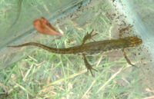
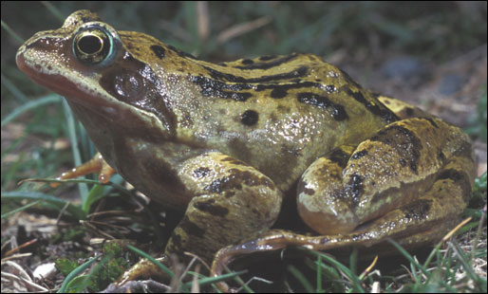
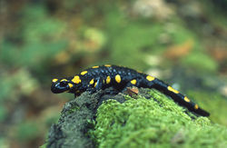
Amphibians
Characteristics:
They are vertebrates.
Are ectothermic (cold-blooded). .
Spend at least part of their lives in water and on land.
Do not have scales and their skin is permeable (molecules and gases can pass through).
Have gills for at least part of their lives.
Some species have gills only as larvae, while others can have gills throughout their lives.
Most amphibians go through metamorphosis.
Newt
Frog
Salamander

Slide 10
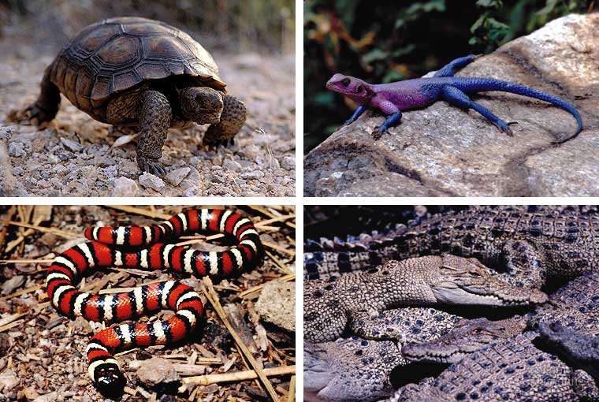
Reptiles
Characteristics:
They are vertebrates.
Reptiles are covered in scales.
Reptiles breathe with lungs.
Most reptiles lay eggs. Some reptiles, like the boa constrictor, give birth to live young.
Almost all reptiles are ectothermic (cold-blooded).

Slide 11
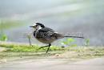
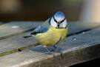
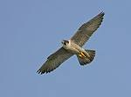
Birds
Characteristics:
They are vertebrates.
All birds have feathers.
All birds are endothermic (warm-blooded). They can regulate their body temperature.
Female birds lay eggs. Their young develop inside of the egg.
Birds have wings, but not all birds use them to fly. Penguins and ostriches are examples of birds that do not fly.

Slide 12
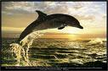
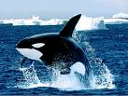
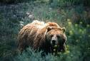
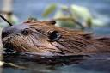
Mammals
Characteristics:
They are vertebrates
Are endothermic (“warm-blooded”)
Have hair on their bodies.
Have mammary glands that produce milk to feed their babies.
Most are born alive
Notes:
All mammals are warm-blooded vertebrates.
Mammals show an incredibly diverse range of body forms and behaviours but six defining features unite them all.
Mammals have mammary glands and are the only animals where the young suck milk from their mothers.
Mammals are the only animals to have hair at some point in their development.
In mammals, the lower jaw is always composed of just one bone.
The three bones of the ear – the hammer, anvil and stirrup – evolved from the jaw and are only found in mammals.
The mammalian heart has four chambers. Mammals have a diaphragm that completely separates the thorax in the upper body from the abdomen below.
The duck-billed platypus and the echidna are the only mammals that produce eggs instead of giving birth to live young.
The smallest mammal on the planet is the hog-nosed bat, which only weighs about two grams. It is also known as the bumblebee bat, because of its size.
A nursing blue whale mother produces over 200 litres of milk a day for its young.
Mammals first appeared during the Jurassic period, almost 200 million years ago. They actually evolved from reptiles into small mouse-like forms. It was only once the dinosaurs became extinct that larger mammals began to appear. There are now more than 4000 different species of mammals living on the planet.

Slide 13
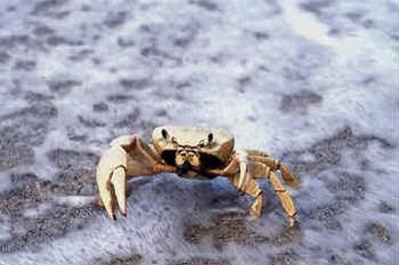
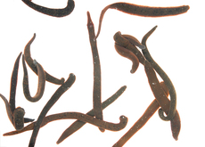
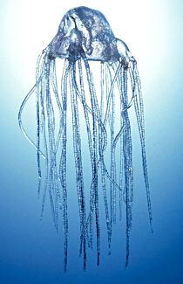
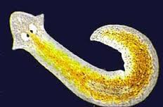
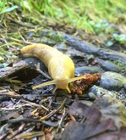
invertebrates
Use the specimens provided and the following slides to complete the worksheet

Slide 14
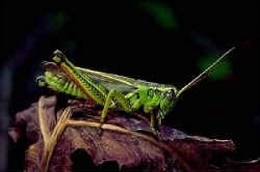
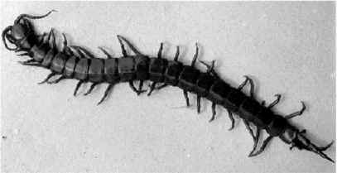
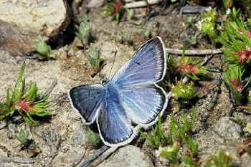
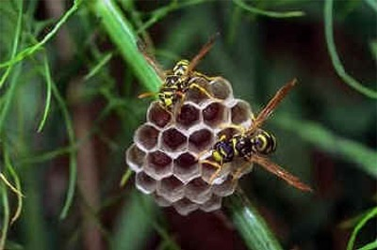
arthropods
The largest animal phylum -- about 85% of all known animals in the world are part of this class
A segmented body.
body made up of more than one part.
Many jointed legs or limbs.
spiders have 8 legs, millipedes can have hundreds!
An exoskeleton.
external skeleton
protects the arthropods body.
Ectothermic (Cold blooded)
Can’t regulate their own body temperature
Bilateral body symmetry.
they're the same on both sides
Examples: spiders, insects, centipedes, mites, ticks, lobsters, crabs, shrimp, crayfish, krill, barnacles, scorpions

Slide 15
cnidarians
Examples: jellyfish, sea anemone, coral
Water animals
Simple, usually symmetrical, body with a mouth opening.
All have stinging cells on tentacles around the mouth catch prey.
Either bell-shaped and mobile, like the jellyfish, or tubes anchored to one spot, like coral and sea anemones.
Many are able to reproduce asexually (without mating) and sexually.
There are 9,000 species.

Slide 16
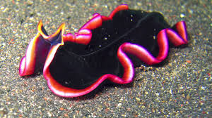
platyhelminthes
Examples: Flatworms :tapeworms, monogenean, flukes
Bilaterally symmetrical.
Body having 3 layers of tissues with organs and organelles.
Body contains no internal cavity.
Possesses a blind gut (i.e. it has a mouth but no anus)
Has normally a nervous system of longitudinal fibres rather than a net.
Generally flattened.
Reproduction mostly sexual as hermaphrodites.
Mostly they feed on animals and other smaller life forms.

Slide 17
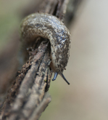
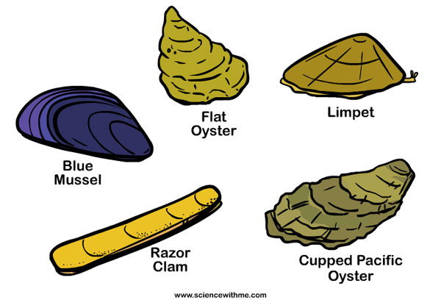
mollusca
Examples: snails, clams, squids and octopods
Molluscs have soft bodies
bodies are not divided into rings
don't have legs, though some have flexible tentacles for sensing their environment or grabbing things.
Most mollusc species grow a hard shell for protection, but their shell grows in only one or two pieces.
It doesn't have joints like the exoskeletons of insects and crustaceans .

Slide 18
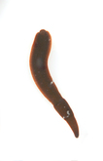
annelida
Examples: earthworms, leeches, polychaetes
have no legs
no hard skeleton
bodies are divided into many little segments, like rings joined together.

Slide 19
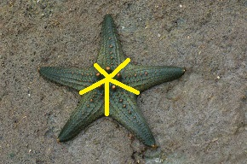
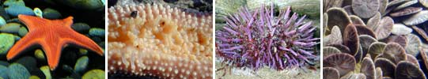
echinodermata
All echinoderms are invertebrates.
can only live in the ocean
have spiny or bumpy skin.
have radial symmetry on their bodies.
reproduction is usually sexual though several species of echinoderms, such as sea stars and sea cucumbers, can also reproduce asexually
Starfish, sand dollars and sea urchins

Slide 20

Mindmap
Chordates
Arthropods
Amphibians
Cnidarians
Platyhelminthes
Mollusca
Annelida

